Slide 1
Generative AI: Applications
To-do-Task: n8n_Solo

Slide 2
What is n8n?
n8n is a low-code automation tool that lets you connect APIs, cloud services, and logic without writing full apps.
Visual programming (drag & drop logic)
Connects to 300+ tools (Google, Slack, OpenAI, etc.)
Great for automating multi-step workflows
Can run locally or in the cloud
Free and open source( for a limited time)
https://cloud.n8n.io

Slide 3
What the AI Agent Does
Automate onboarding of new clients across platforms.
When a form is submitted:
A Google Drive folder is created
A new Slack channel is created
A ClickUp list is generated
A welcome email is prepared using OpenAI
Client receives a Slack message
Why this matters:
Saves time, ensures consistency, and gives clients a smooth onboarding experience.

Slide 4
Tools Integrated in Workflow
Tool | Purpose
n8n | Automates and connects all services visually
Google Drive API | Creates folders for each client
Slack API | Sets up communication channels
ClickUp API | Adds tasks for onboarding
OpenAI (GPT) | Writes welcome message content

Slide 5


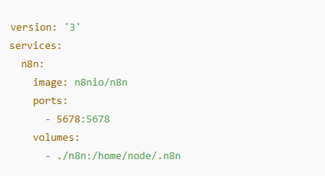
Local Setup of n8n
Install Docker
  Download from https://docker.com
  Confirm install: docker –version
2. Create project directory
3. Create Docker Compose File
Add the following inside

Slide 6

Local Setup of n8n
4. Start n8n
5. n8n should now be running at: http://localhost:5678

Slide 7
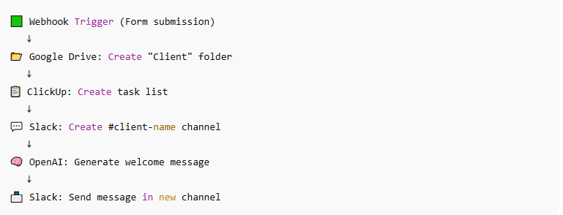
Workflow Diagram

Slide 8
Connecting Google Drive in n8n
In n8n, go to Credentials > New
Choose Google Drive OAuth2 API
Connect your Google account (make sure to create an “Onboardings” folder first)
In the workflow, use the Google Drive node to:
  Create folder
  Set folder name = client’s name or ID
If “Access Denied”: make sure your OAuth client is set for external use and you’re a test user.

Slide 9
Connecting ClickUp in n8n
Go to ClickUp → Settings → API
Generate a personal access token
In n8n, create a ClickUp API Credential
Use ClickUp nodes to:
  Create a Folder
  Create a List
  Add Tasks
Error Fix: If ClickUp returns "Folder not found", make sure the folder doesn't already exist (ClickUp ignores duplicates)

Slide 10
Slack Setup in n8n
Go to Slack API portal → Create App
Add permissions:
  channels:write
  chat:write
  groups:write ---- this is for private channels( optional)
Install app to your workspace
Copy OAuth Token into n8n credential setup

Slide 11
Using OpenAI in n8n
Create an OpenAI API key
In n8n:
  Add OpenAI API node
  Use ChatCompletion with “You are a helpful onboarding assistant.”
Prompt Example:
Create a warm welcome message for a new client named Windows, joining our platform today.
OUTPUT:
“Welcome Windows! We’re thrilled to have you on board. Let’s get started!”

Slide 12
Common Issues & Debugging
Issue | Fix
“Missing OAuth scopes” | Add correct Slack/Google API scopes manually
ClickUp folder not created | Delete duplicate folder and rerun
OpenAI quota errors | Use gpt-3.5-turbo or upgrade plan
Slack can’t post | Use correct channel ID and chat:write scope
Google Drive “Access Denied” | Ensure test user is added to Google project

Slide 13
What I Learned
Designed and deployed a multi-platform automation agent
Understood OAuth credential setup and API rate limits
Gained confidence using n8n as a low-code automation tool
Successfully orchestrated multiple services (Slack, Google, ClickUp, OpenAI)
Improved debugging across multiple APIs

Slide 14
Automating Job Applications – n8n

Slide 15
Automating Job Applications using n8n, Ampify, and ChatGPT
Overview
Problem: Repetitive, time-consuming job applications
Goal: Fully automate job scraping, rating, and cover letter writing
Tools: n8n, Ampify Web Scraper, OpenAI API (GPT-4.0 mini), Google Sheets

Slide 16
Why These Tools Were Chosen
n8n: No-code/low-code workflow builder, free self-hosted or cloud version
Ampify: Reliable no-code scraper with webhook support( also gives $ 5 signup bonus which basically helps you scrape 100 jobs/day for a month)
GPT-4.0 Mini: Fast + cost-effective AI model
Google Sheets: Easy way to store and view data

Slide 17
Create All Required Accounts
n8n account (cloud or self-hosted)
Ampify account (and request actor access)
OpenAI account + get API key
Google Cloud setup for Google Sheets API (optional if using webhook + sheets)

Slide 18
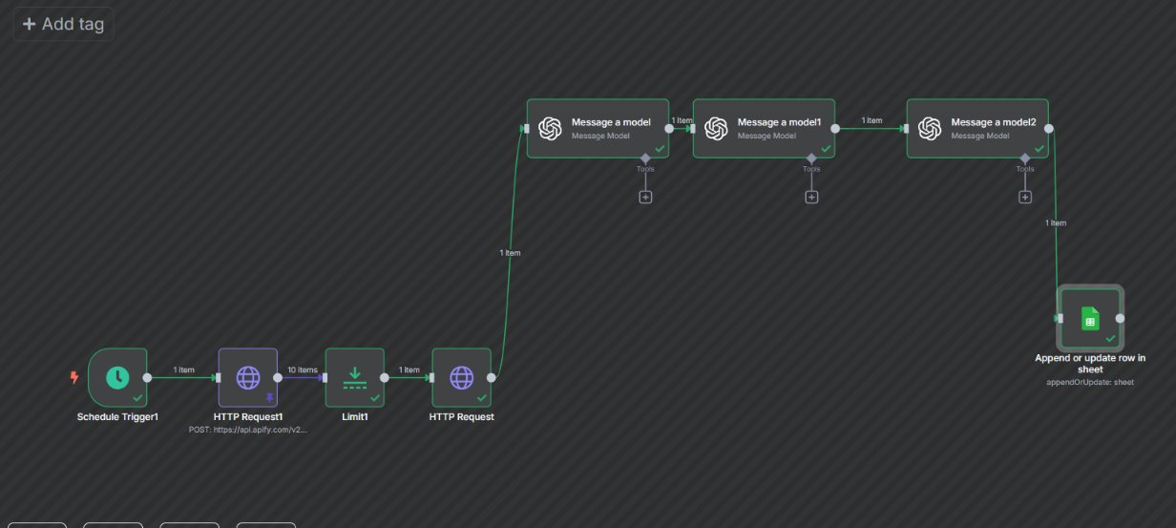
workflow
Workflow comprises of 3 Gpt models acting on 3 different instructions.

Slide 19
Amplify web scraping
What is Web Scraping?
Web scraping is the process of automatically extracting data from websites. A scraper program sends requests to a webpage, processes the HTML response, and extracts the relevant information — like job listings, product prices, or weather data.
What is AWS Amplify?
This refers to using AWS Amplify’s serverless backend to perform web scraping, especially using AWS Lambda functions (which are often managed via Amplify CLI or Amplify Studio).
What are Actors?
Actors are serverless cloud programs ideal for web scraping and automation. They are easy to develop, share, and build upon. They can be started manually using our API or scheduler, and they can be easily integrated with other apps.

Slide 20
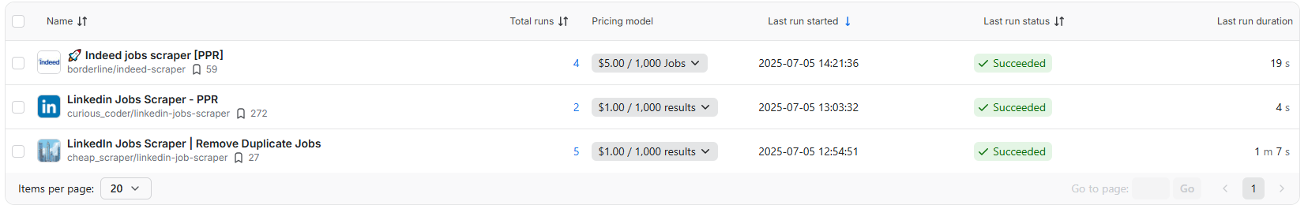
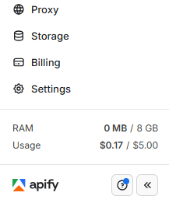
Finding actors
Once you sign in to Ampify, they provide you with $5 balance and you can search for online sources you could scrape information out of.
These actors tell you exactly how much they will charge for scraping.
You initially get $5 as signup bonus.

Slide 21
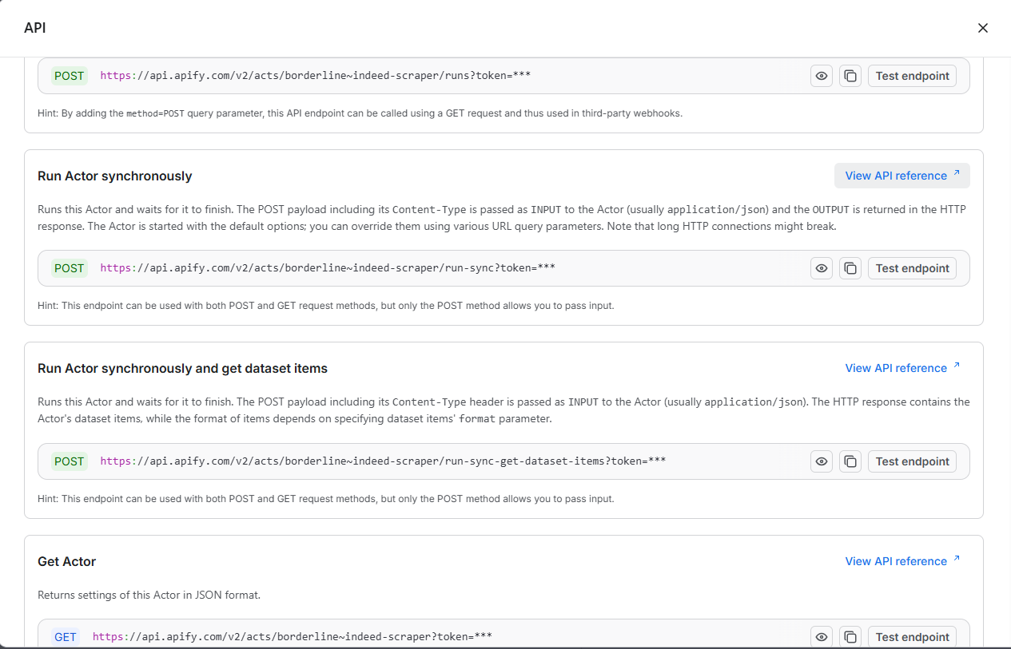


Finding actors
We will use Run actor Synchronously to test the endpoint.

Slide 22
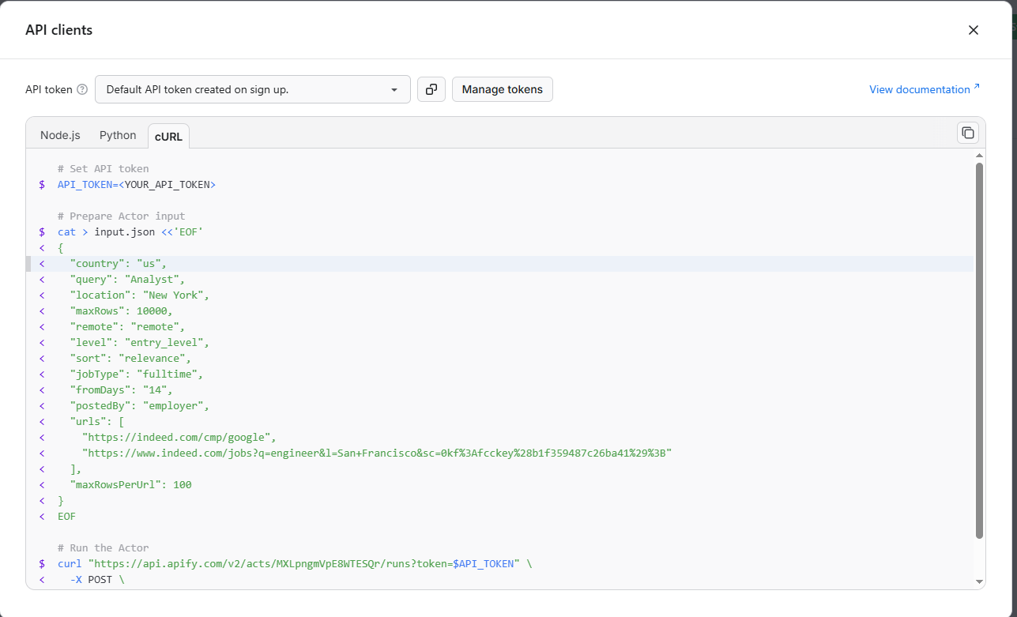


Finding actors
We will use the API token in the form of curl to copy directly into the n8n Http request.

Slide 23
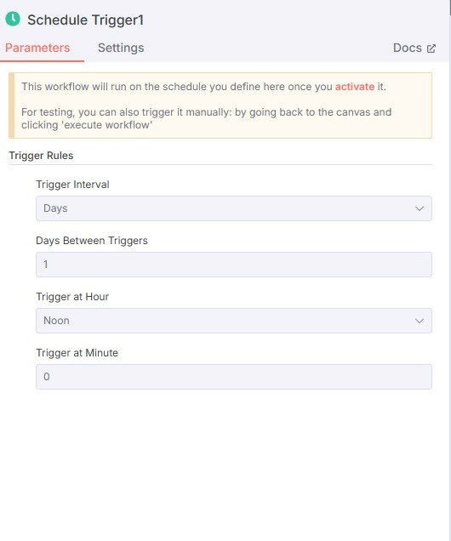
Step 1 : SET UPA TRIGGER​
A Trigger is the starting point of an automation workflow in n8n. It "listens" for a certain event — such as receiving a webhook, a new email, a scheduled time, or a new database entry — and starts the workflow when that event occurs.
Here we are setting up a trigger for every day at 12 pm. This way this automation will run everyday exactly at noon and extract all the information needed.

Slide 24
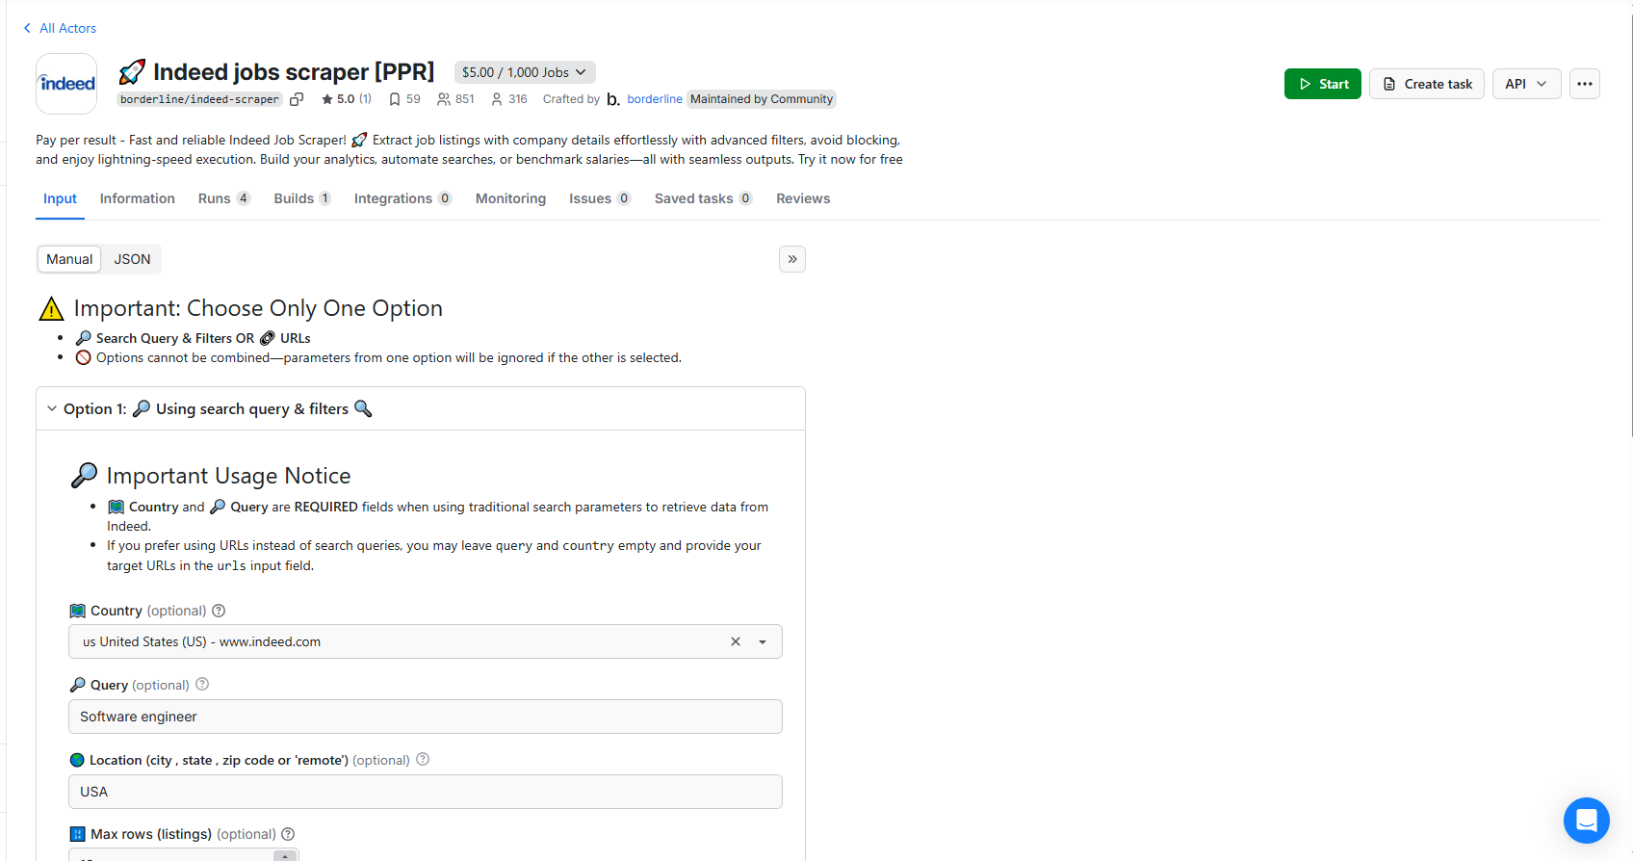
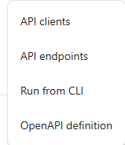

Step 2 – JobScrapingusing Ampify​
The HTTP Request node in n8n lets you make requests to any API endpoint using different HTTP methods (GET, POST, PUT, DELETE, etc.). You can use it to send or retrieve data from external systems — even if there’s no built-in n8n integration.
Here we will connect Ampify to the http request in n8n.
We are going to use API endpoint and CLI for connecting it to the http request.
Click on API,

Slide 25
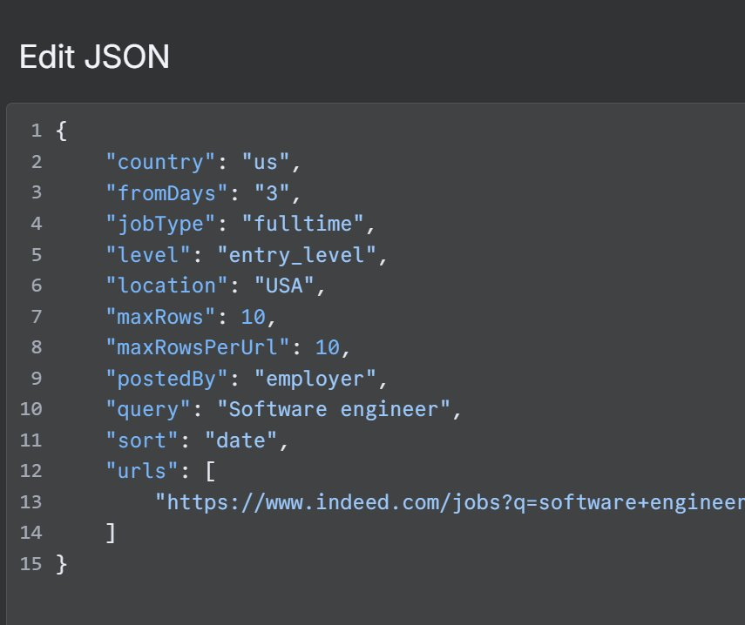
Step 2 – JobScrapingusing Ampify​
On the side is the http request from Ampify actor to our n8naccount. ​
In the edit JSON section we can see all the selections we have chosen. ​
Most important selection would be to select max rows to be 10.​
If we don’t set the max rows section, the Actor will scrape over1000 listing at a time and cost a lot.​

Slide 26
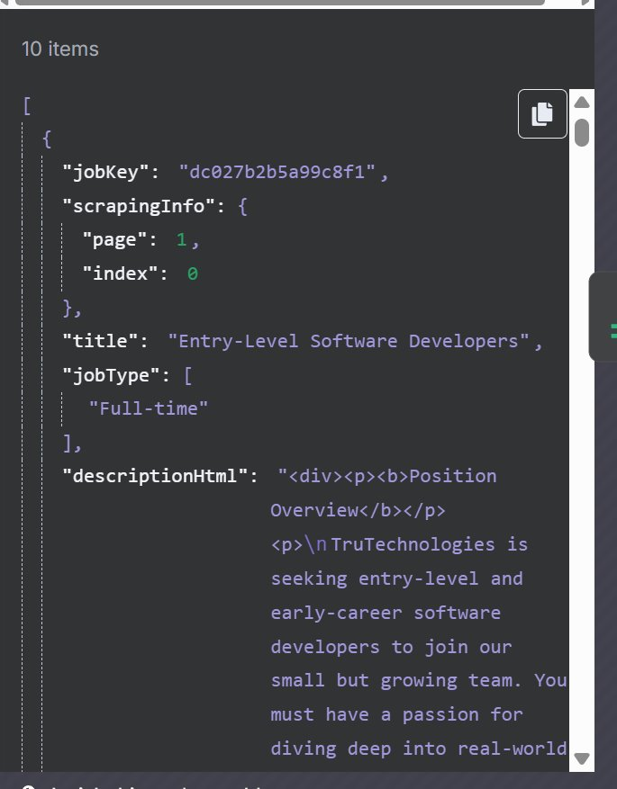
Output of HTTP request​
Once the connection is done, we can run the trigger once for testing and see what the output of http request is going to be.
As expected we have our 10jobs along with their description and title.​
We can pin a single result to make sure our entire work flowworks before running all 10 job postings.​

Slide 27
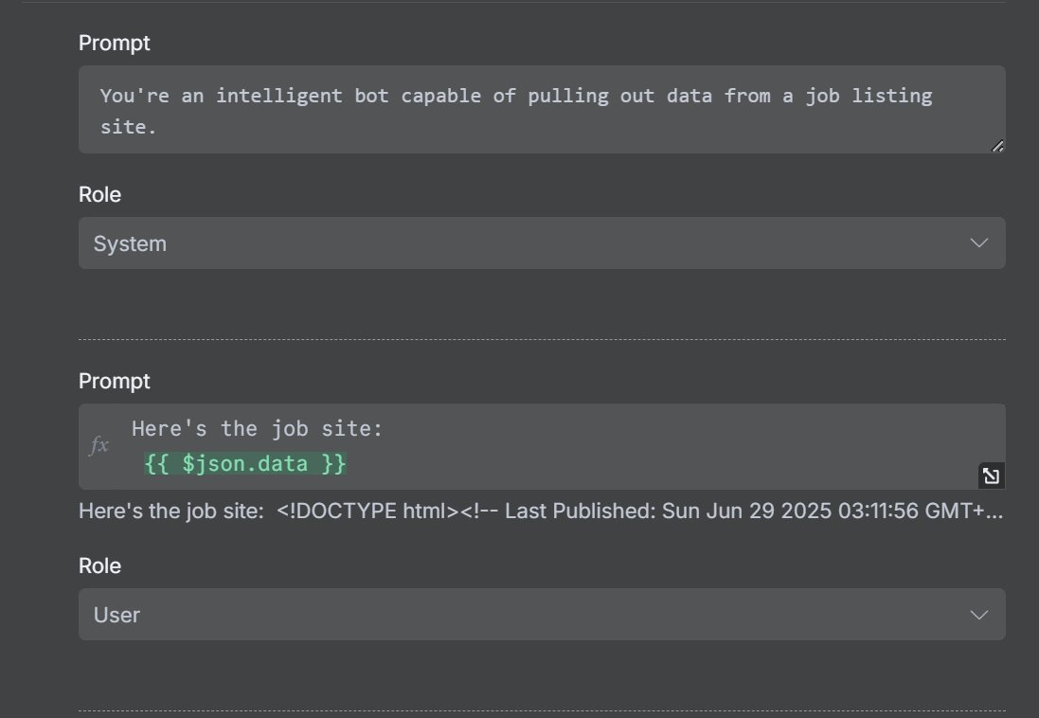
Chat GPT Models
We will be using 3 models for this project.
Model 1: Extract Information
Send job JSON to GPT with:
System prompt: “You are an intelligent bot that extracts key info from job posts.”
Output: Cleaned, parsed job data
Sample JSON input and GPT response

Slide 28
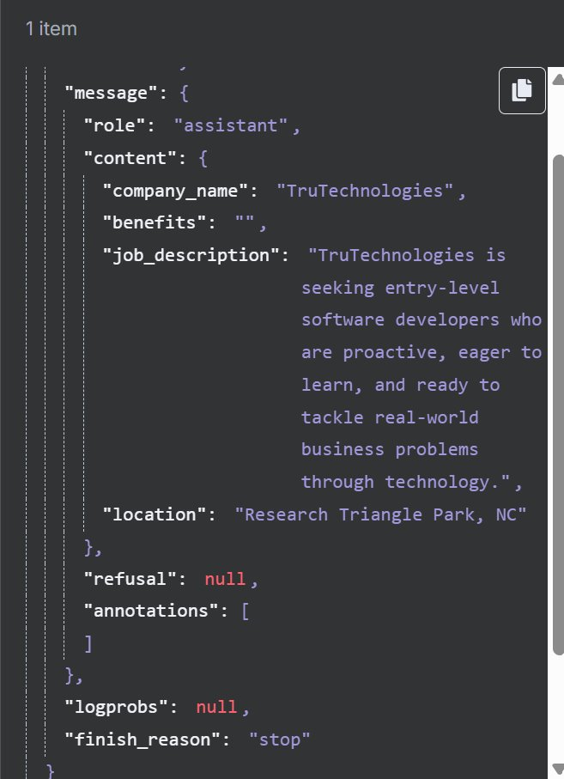
OUTPUT of MODEL1​
The output from model 1 provides us with all the needed information.​
If any required information is not provided on the job listing, it will return with 0.​
The output will usually consist all of the critical information like the name of the company, description of job and location.

Slide 29
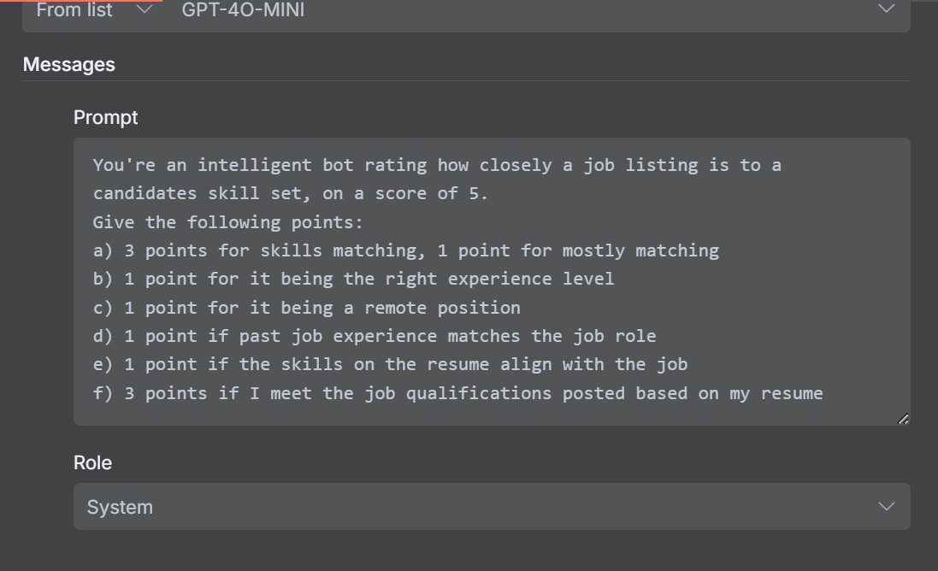
Chat GPT Model 2 --- Relevance Rating
The second model is used to tell us how well the job description matches our resume.
System prompt: “Rate how well this job matches the following resume.”
Include your resume and job details
Output: Score (0–5) with reasoning
3 points for skill matching
1 point each for being the right experience level and location.

Slide 30
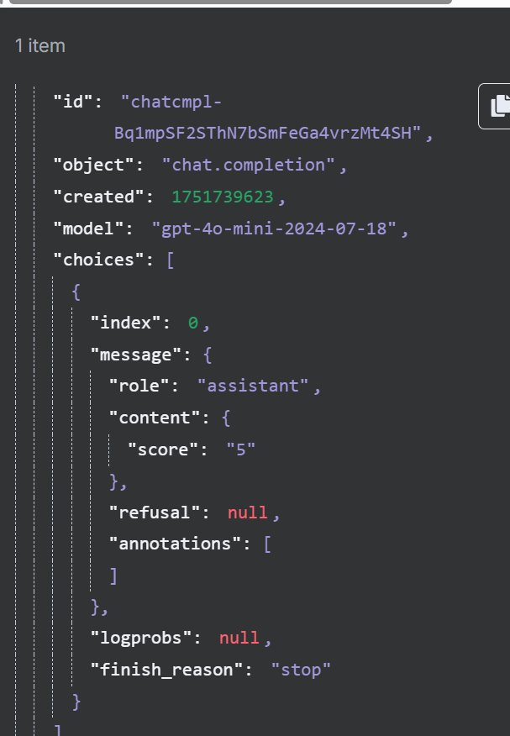
Output from Our Model 2
Here we used one job as testing instead of going for all the jobs at once to make sure everything was running smooth.
The first job gave us a result of 5/5 because it matched all the descriptions.

Slide 31
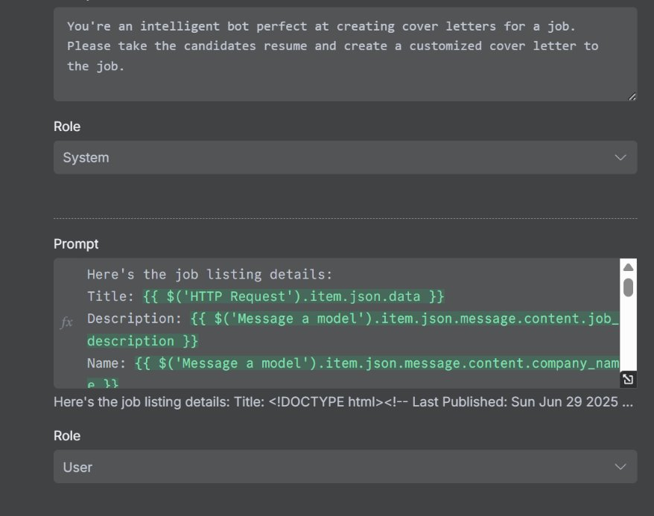
Chat GPT Model 3 --- Generate Cover Letter
Prompt includes job + resume
System prompt: “You’re a perfect cover letter writer.”
For our user prompt we provide the model with the job listing and our resume to provide a unique cover letter for all job postings.​
Output: Tailored cover letter

Slide 32
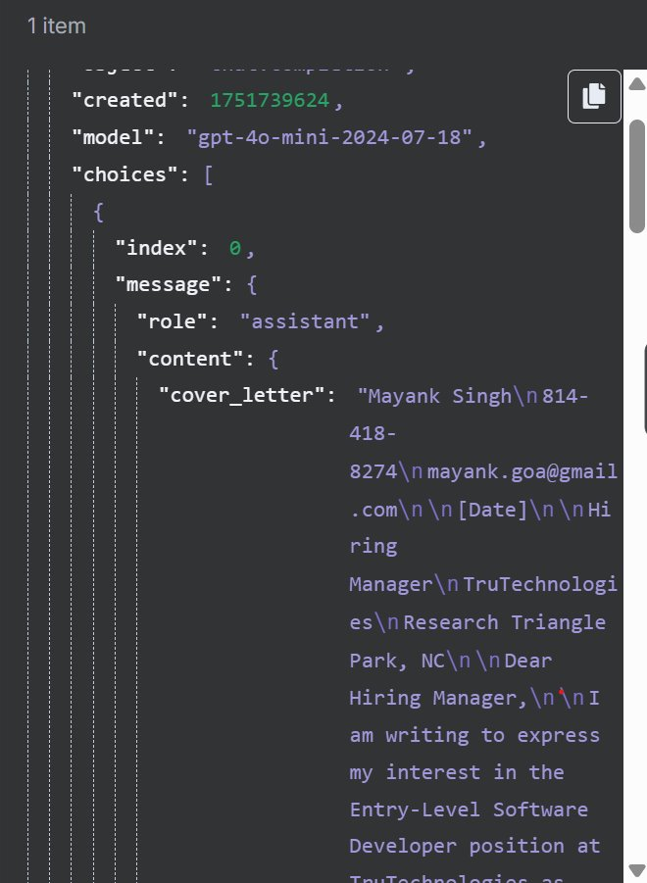
Output from third model
The output from the third model provides a perfectly tailored cover letter ready to be sent out. It aligns your resume with the job description and outputs a cover letter of your length.

Slide 33
Google Sheets- Step 1
Go to Google Cloud Console
Sign in with your Google account.
Create a New Project (or select an existing one)
Enable the Google Sheets API
Go to: APIs & Services → Library
Search for Google Sheets API
Click Enable
Set Up OAuth Consent Screen
Go to: APIs & Services → OAuth consent screen
Choose External for user type

Slide 34
Google Sheets- Step 2
Add Google Sheets Credentials in n8n
Choose Google Sheets OAuth2 API
Enter: Client ID and Client Secret from Google
Click Connect
A window will open → Sign in with your Google account → Accept permissions

Slide 35
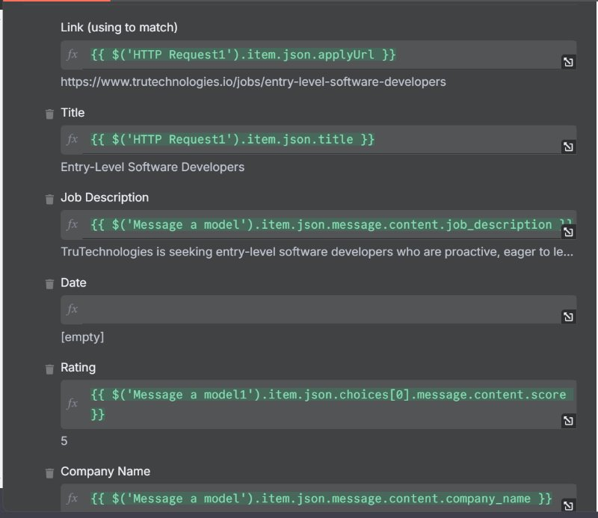
Send All Data to Google Sheets
For our final part of the flow, we provide all the information as an input for our google sheet.​
The google sheet will keep all job posting based on unique links so that the same job doesn’t not get in the sheet again.​
Append unique job entries only
Columns: Company, Job title, Description, Rating, Cover Letter, Link

Slide 36
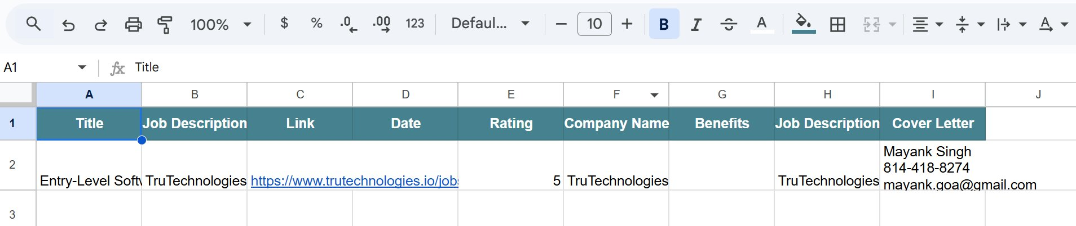
Output from the google sheet
The sheet gets updated everyday at noon with all the important information like the company name, Job description and Link to the job posting.​
2 really important features are the rating and unique cover letter for all the job postings.​
All you need to do is click on the link to apply to job & copy and paste the cover letter along with your resume.

Slide 37
AI WhatsApp Chatbot Using n8n, GPT-4.0 Mini, and WhatsApp

Slide 38
Introduction
This project automates conversations on WhatsApp by integrating an AI chatbot using n8n, GPT-4.0 Mini, and WhatsApp Cloud API.
The bot can interpret both text and image inputs and respond accordingly. It serves as a 24/7 assistant for customer support, education, or personal tasks.
Key Benefits:
Instant replies powered by GPT-4.0 mini
Cost-effective and fast inference
Fully automated and scalable system

Slide 39

What the Bot Can Do
Text Questions: Answers factual, conversational, or task-based queries
Image Interpretation: Generates captions or analyzes uploaded photos
Smart Replies: Remembers previous prompts in a session
Multi-use: Customer support, helpdesk, feedback system
Hands-free access: Just chat on WhatsApp, no app needed

Slide 40
24/7 AI Chatbot over WhatsApp using GPT-4.0 Mini + n8n
Goal: Smart AI assistant on WhatsApp
Tools: n8n, OpenAI GPT-4.0 Mini, WhatsApp Cloud API (Meta for Developers)
Why These Tools Were Chosen
  WhatsApp Cloud API: Official, reliable, supports text/image
  GPT-4.0 Mini: Cost-effective, fast inference
  n8n: Orchestrates the message → AI → reply flow

Slide 41
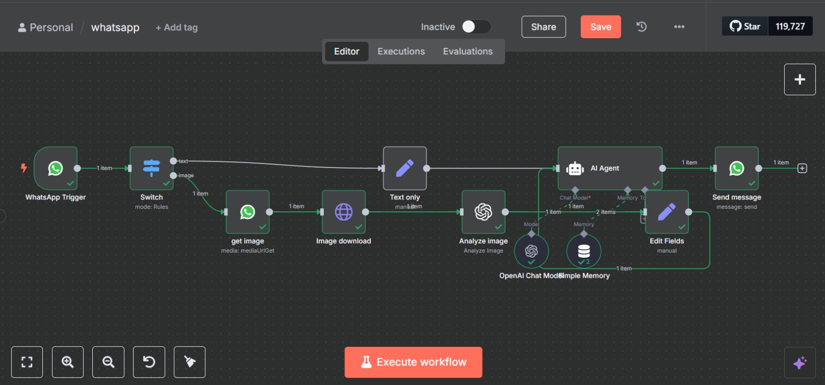
Workflow

Slide 42
Create All Required Accounts
Meta Developer Account: https://developers.facebook.com/
Register App → Enable WhatsApp
Get:
      Phone Number ID
      Access Token
      Webhook URL (from n8n)
      Add a test phone number via Meta dashboard
Configure n8n Webhook
Webhook node receives WhatsApp messages
Add fields for:
    Text content
    Media ID (if image sent)

Slide 43
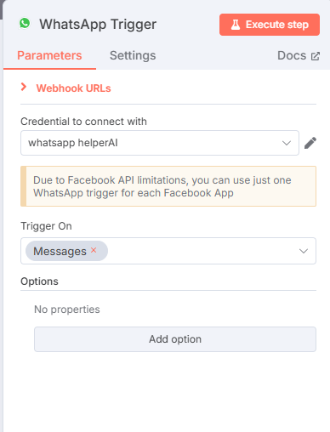


Step 1 : Set Up WhatsApp receiver
Due to the API limitations, we could only use one trigger at a time.
Configured using WhatsApp Business Cloud API:
1. Registered app on Facebook for Developers
2. Webhook set to receive messages and media
3. Access token and phone number ID integrated into n8n
4. Triggers whenever a new message is received

Slide 44
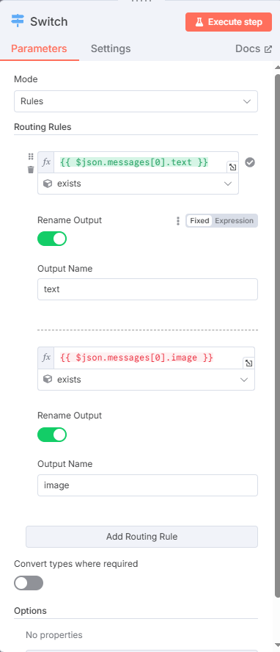
Switch
The Switch node lets you define multiple conditions and route the flow of the workflow depending on the value of a specific field.
Instead of using multiple IF nodes, you can handle multiple cases in a cleaner and more efficient way.
This node checks if the incoming WhatsApp message contains:
Only text (→ go to GPT directly)
An image (→ go to image download step)
This conditional logic ensures the flow follows the correct path.
If message has text → Send to GPT
If message has image → Download → Analyze with GPT
Else → Default message (error or fallback)

Slide 45
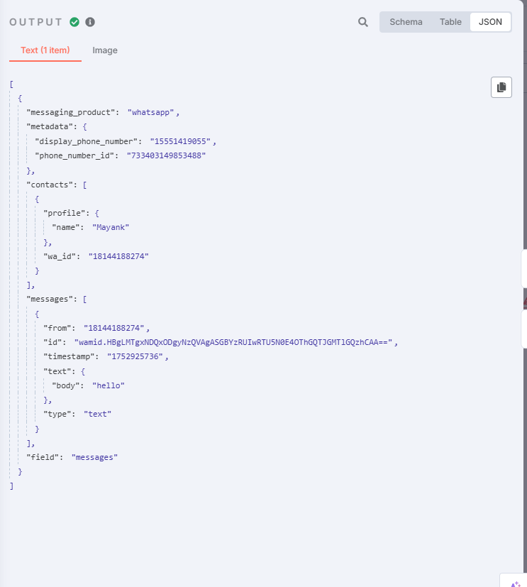


OUTPUT Of Switch
Here my input message “ Hello” was counted as a text type and sent directly to the next step instead of going through download image.

Slide 46
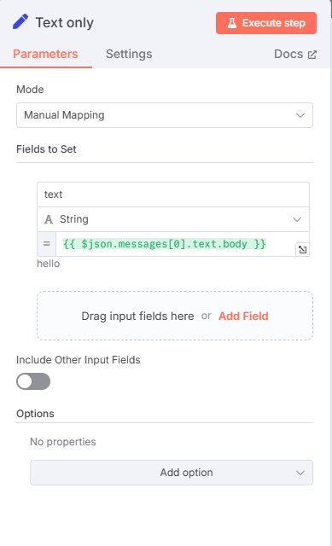
Text only Input
Once a text message is received:​
Message content is extracted​
Sent to OpenAI GPT-4.0 Mini via HTTP Request node​
AI generates a smart, relevant response​
Message is sent back via WhatsApp​
Quick, simple, and intelligent.​

Slide 47
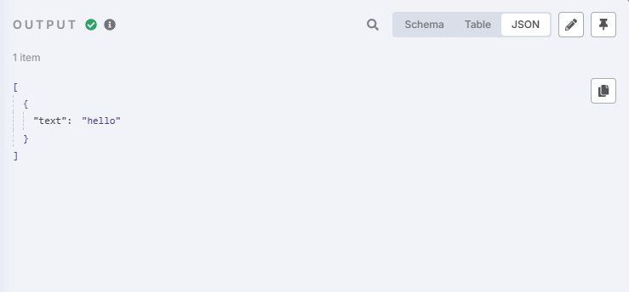
Output oftext only​
The text sent by the user is extracted and send to GPT for analysis.

Slide 48
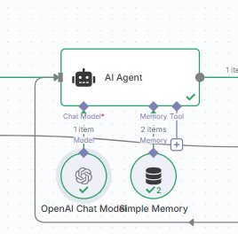




AI Agent​
AI Agent also has a simple memory that stores all the past conversations.
In this node:​
GPT-4.0 Mini is prompted with the user message​
Optional system prompt used to control tone/personality​
Temperature and max tokens configured for consistency​
Returned message is passed to the WhatsApp API node​
​
Ai agent consist of GPT- 4.0 mini.

Slide 49
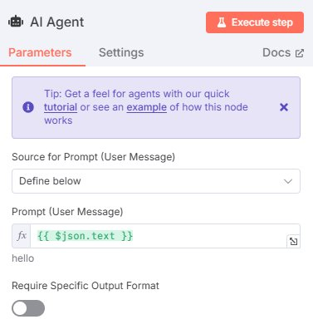
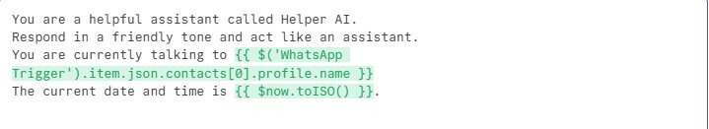
Contents of AI-Agent​
AI Agent is instructed to be a helpful Agent.
System prompt:
“ you are a helpful assistant called Helper AI”
“respond in a friendly tone and act like an assistant”

Slide 50
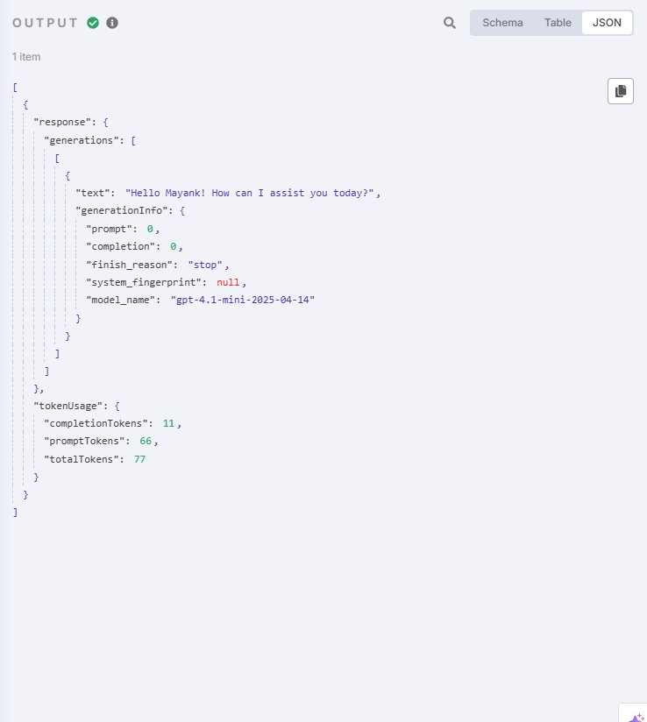



Output of GPT 4.0 mini​
Sample input: “Tell me something about diabetes.”​
Sample output: “Diabetes is a chronic condition that affects how your body processes blood sugar. It can be managed through medication, diet, and exercise.”​
Output is concise, context-aware, and informative.​
Input 1: sender → “hello”
Response: “ Hello Mayank! How can I assist you today?”
Response from Chat- Gpt
Token usage information.

Slide 51
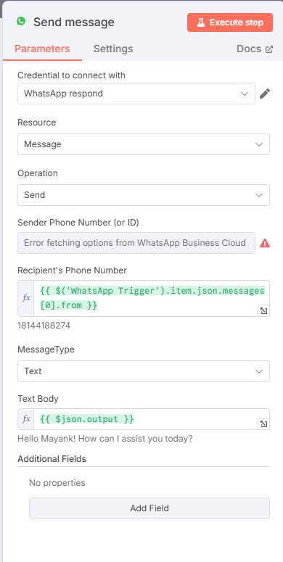
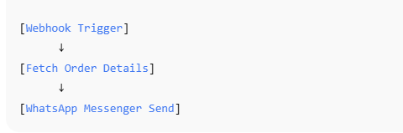


Whatsapp messenger
Sender
the WhatsApp Messenger Send node that lets you automate sending WhatsApp messages by connecting to a WhatsApp Business API account, not a personal WhatsApp account.
This is the phone number we can grab from the initial text message.
The text body is the output from GPT that needs to be sent out through WhatsApp.

Slide 52
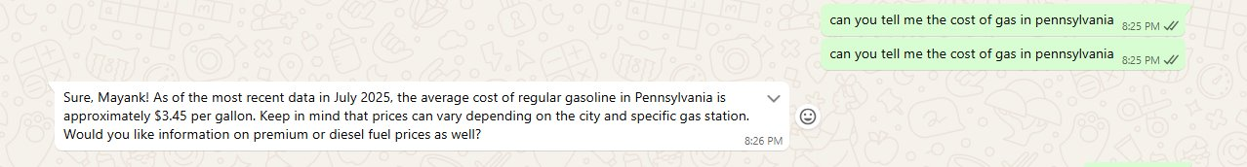
Final WhatsApp response -- text​
Asked Helper AI with text " can you tell me the gas price in Pennsylvania"​
Helper AI responded with " Sure, Mayank! As of the most recent data in July 2025, the average cost of regular gasoline in Pennsylvania is approximately $3.45 per gallon. Keep in mind that prices can vary depending on the city and specific gas station. Would you like information on premium or diesel fuel prices as well?"​

Slide 53
Image input to our AI-Helper
WhatsApp media webhook captures image ID. n8n downloads the image via WhatsApp API
If the switch detects an Image input it will redirect it towards the image section and the whole process will work seperately.
Switch will redirect it towards get image from WhatsApp to .

Slide 54
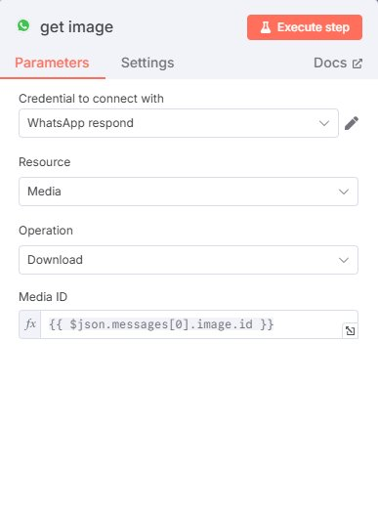


WhatsApp get image​
WhatsApp Get image receives image id from the WhatsApp Webhook and retrieves media URL using WhatsApp Cloud API.
The image is temporarily stored in the form of JSON image.id
Only JPG and PNG types currently supported.
Media is stored in Json image.id form

Slide 55
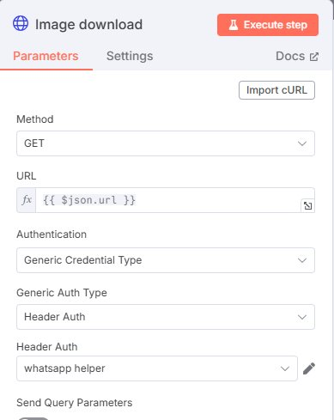


Image downloader​
the Image Downloader download an image from a URL, then process it, save it to a file system, upload to cloud storage (like S3), send over email, or pass it to another API.
Image media ID is converted to a downloadable link​
n8n uses HTTP GET with bearer token​
File is prepared for processing​
Output is sent to the next step: "Analyze Image"​
JSON url is used as input to download the image.

Slide 56
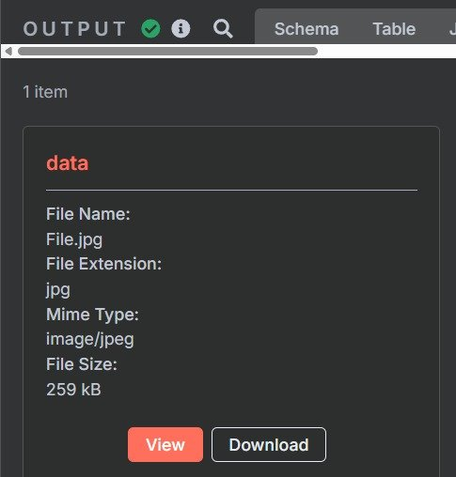
Output of Image downloader​
The output is a Jpg/image type which is sent to GPT to analyze.​

Slide 57
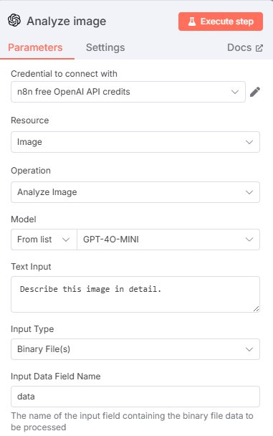




GPT model– Analyze Image
As the name suggests, this 4.0 mini Gpt model analyses an image and gives out the output as instructed by us.
Prompt sent to GPT: "Describe this image in one sentence."​
GPT responds with caption or best guess (e.g., "A man hiking in the mountains at sunset.")​
Supports general object detection, context inference​
Once the free credits are over, the only option is to pay.
Our text input is to describe the image in detail.

Slide 58
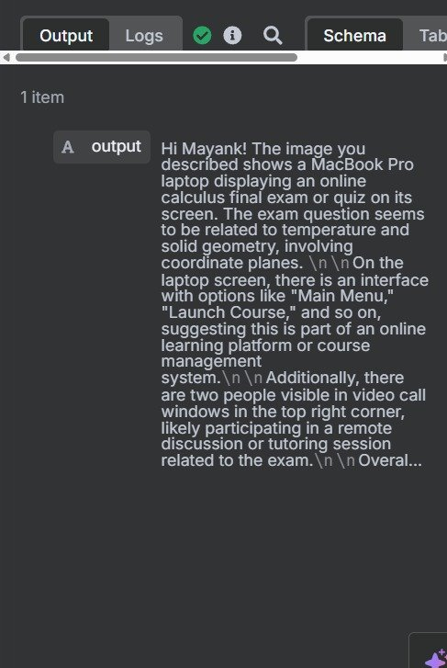


Output of analyze image​
The output from analyze Image gives us a detailed paragraph on what the image is.

Slide 59
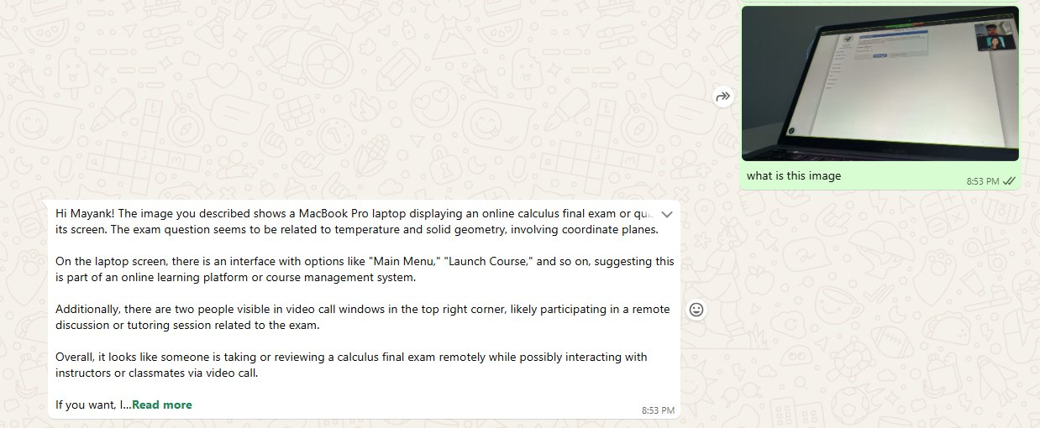



Final output on WhatsApp​
Input given to the AI- Helper
The output when Chat-Gpt was given a picture of student have a zoom meeting discussion of their final exam.

Slide 60
Thank you.

